Slide 1
Twilight CPD
12 January 2021

Slide 3
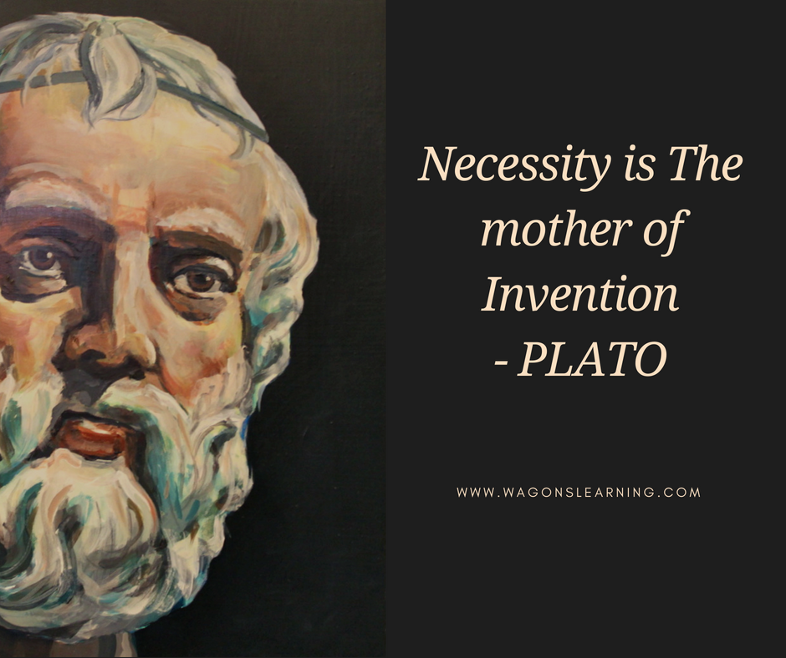

Slide 4
Guidance and resources | EdTech Demonstrator Programme (lgfl.net)

Slide 5
DfE Guidance on Remote Learning
Refers to EEF Guidance...characteristics of good teaching
ensuring pupils receive clear explanations
supporting growth in confidence with new material through scaffolded practice
application of new knowledge or skills
enabling pupils to receive feedback on how to progress
https://www.gov.uk/government/publications/remote-education-good-practice/remote-education-good-practice

Slide 6
https://www.tes.com/news/remote-learning-how-apply-rosenshines-principles
High quality remote teaching should replicate high quality classroom teaching!

Slide 7
High Expectations
Teachers are visible for the full lesson on Teams
Begin by greeting all students and taking a register (a ‘live’ register enables you to iron out any sound issues at the start & builds student confidence in speaking. It also encourages a prompt arrival!)
Before you start, ask them for a hands up if they can hear you.
ROUTINES
Checking homework
Completion of Assignments
Usual four part lesson (SoL written in advance)
Students can have time away from the call screen to work independently (as they would in a classroom).

Slide 8
The live teaching approach will vary according to the lesson being taught...however...
SMART Task (retrieval)
Teacher instruction/modelling
Independent task
Consolidation
Teacher available throughout on live call to answer questions

Slide 9
Utilise lobby time
While students arrive from other lessons, keep them in the lobby.
Use this time to get set up with:
Sharing the PPT
Sharing resources
Admit them all at once a few minutes in once more have arrived.

Slide 10
Holding page

Slide 12
Chat box – use to increase engagement
You could use it to:
Receive responses to SMART task
Receive questions
Type up modelled responses / sentence stems
Share resource links. Get them to like it so they can show you they have looked at it
Post the task e.g. SMART - and ask for likes once completed

Slide 13
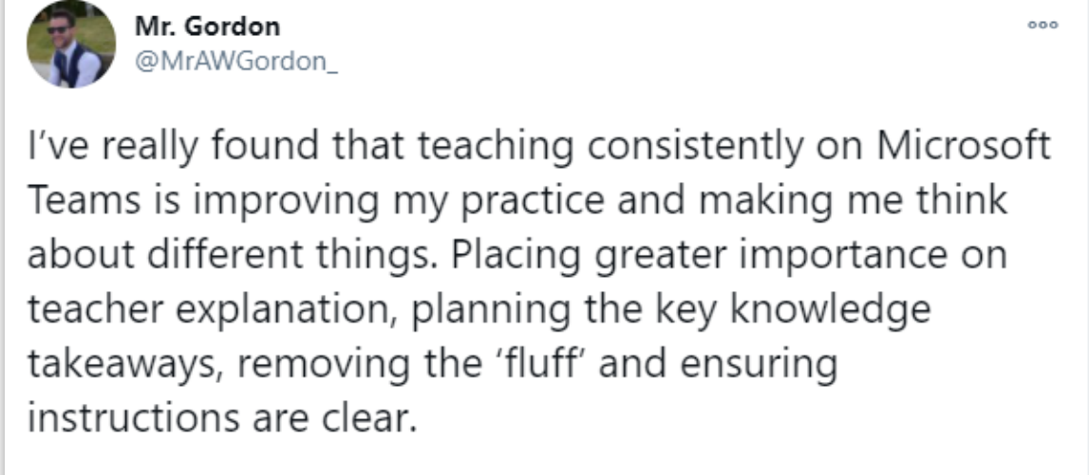
Clarity of instructions
Very important for SEND students
Written instructions work best
Avoid cognitive overload
E.g. 'Once you have finished all of your work and have tried your best, please upload to the Teams Assignment'
Instead use 'Upload completed work to …'
Explain where they are saving work / uploading work once finished.
Ask for hands up to check they understand.
Reduce slide content to the essentials (take out unnecessary images, etc).

Slide 14
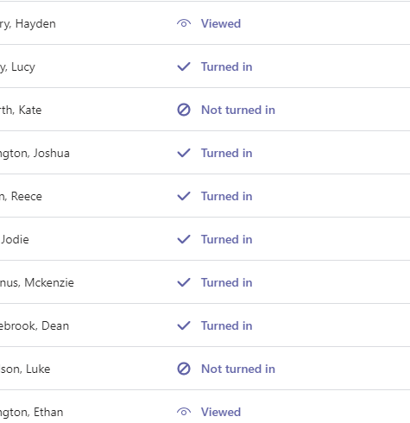
Completed Assignments
Screen shot completed from previous lesson. Shows them we are monitoring closely.

Slide 15
Check usage (Insights)

Slide 19
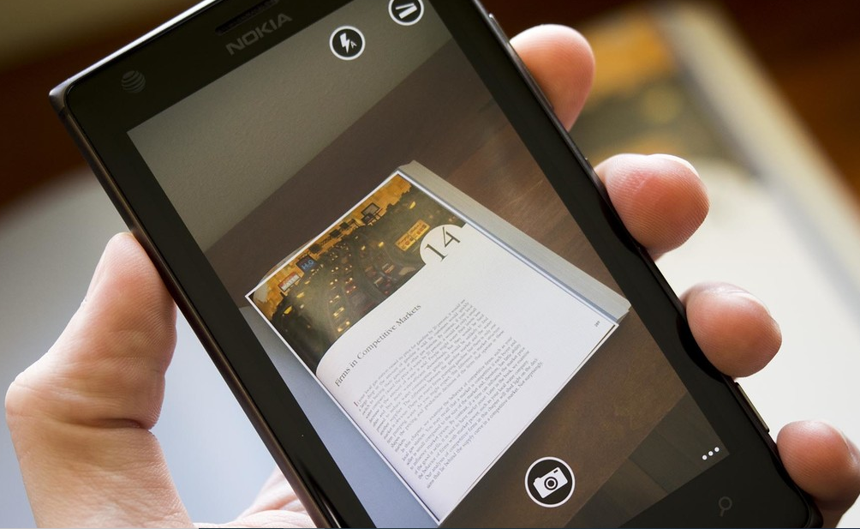
Modelling remotely

Slide 20
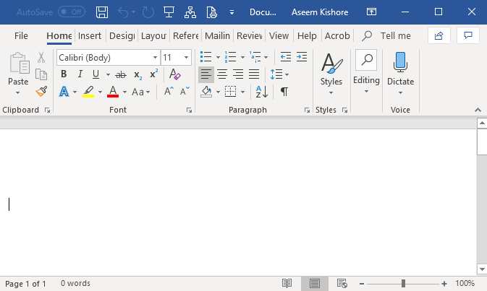
Live document editing (Collaborative working)
Share and edit WAGOLLS & WABOLLS
Give instant written feedback

Slide 21
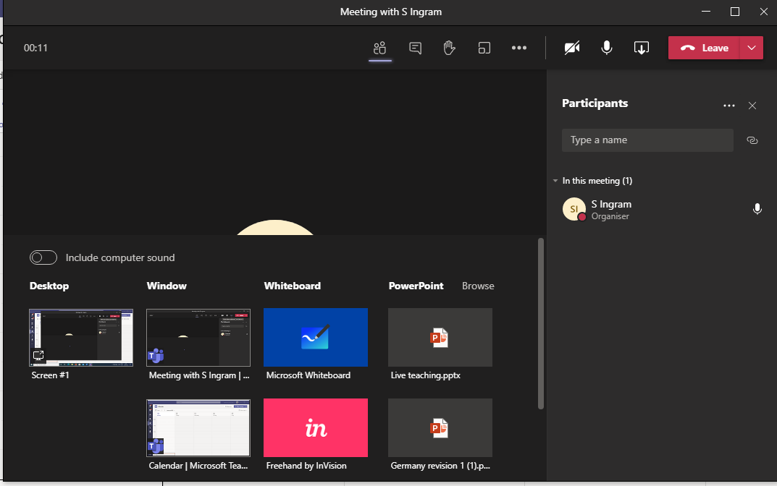
Whiteboard

Slide 22
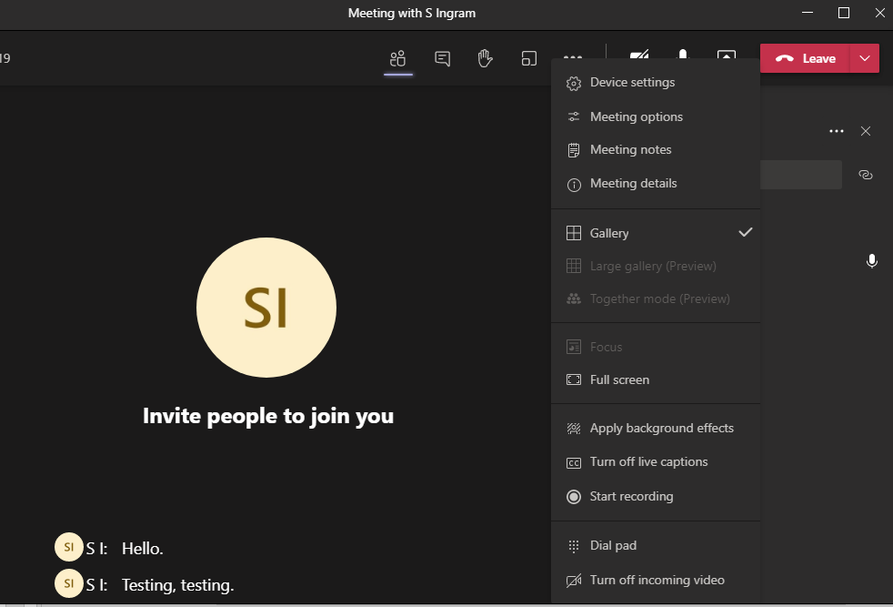
Live captions/subtitles in Teams

Slide 23
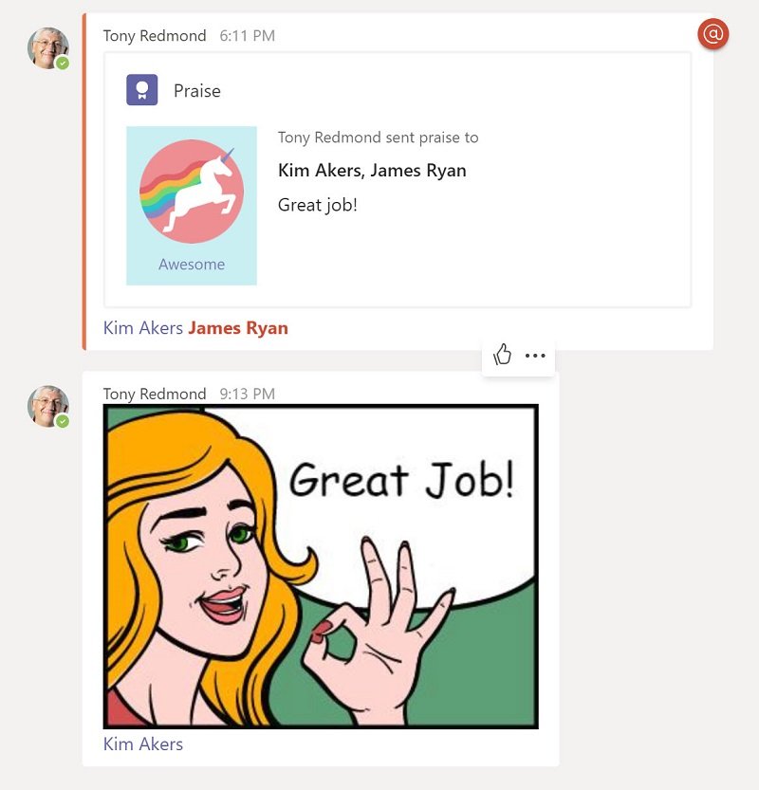
Don’t forget the power of praise- verbal too!
Thank students for contributing

Slide 24
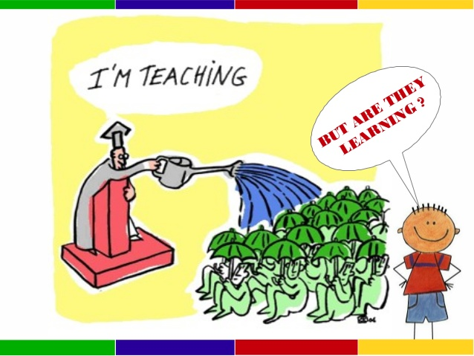
Input and output
How can we get the most of students while they work remotely?
How can we encourage them to engage and interact?

Slide 25
True or false (hands up/down)
MCQs using emojis

Slide 33
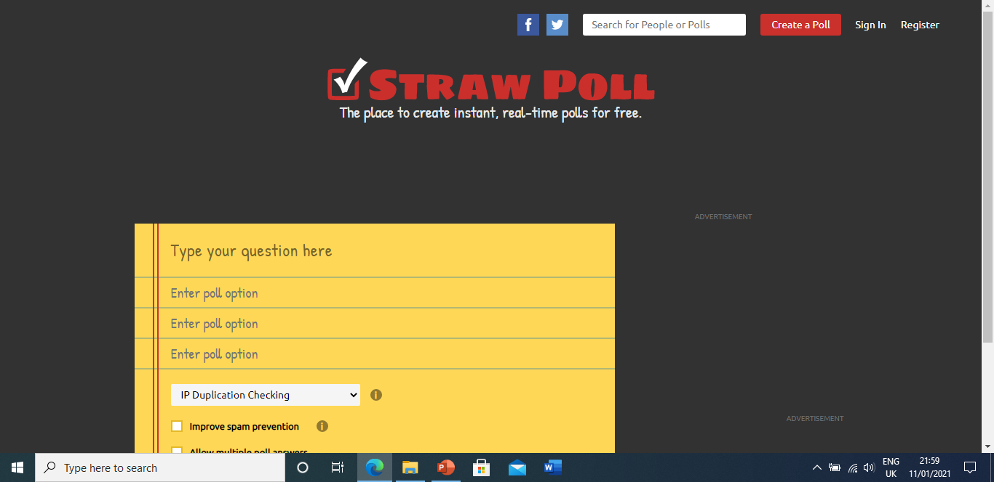
www.strawpoll.me

Slide 34
Breakout rooms
Microsoft-Teams-Breakout-Rooms-One-Pager (1).pdf

Slide 35
Further reading
Online learning: What the DfE expects of teachers | Tes
Coronavirus: 5 ways for teachers to cope with online learning | Tes
Remote Learning Solutions: Crowd-sourced ideas for checking students’ writing | teacherhead
Coronavirus: How to teach and parent simultaneously | Tes
https://www.gov.uk/government/publications/whats-working-well-in-remote-education/whats-working-well-in-remote-education
Online learning: 13 clever teaching hacks for Microsoft Teams | Tes News

Slide 36
Share your Tips and Tricks...we're in this together
SCITT OneDrive shared subject folders
Teams SEDD groups

